Slide 1


PRESENTING YOU
TREES

Slide 2
What actually is B+ Tree?
It’s an another n-ary Tree
It actually is an optimization of B tree
Contains root, internal nodes and leaf nodes like other Trees
Internal nodes contains router value of data in leaves
All data is stored at leaf level
Leaf nodes are linked to each other
19
45
5
17
19
45

Slide 3




WHY B+ Tree?
Unlike B tree, B+ tree stores all the data on leaf level.
They Maximize the branching factors (fanout)
Higher branching factors allows less height
Less height requires less disk I/O
Which means better performance
19
5
17
19
45
O($\log_{b}{n}$)

Slide 4
Properties of B+ Tree
Every node has one more children than it has keys.
All leaves are at the same distance from the root.
If B+ tree has m order then
Root: has between 2 and m children (or root could be a leaf).
Internal Node: store up to m - 1 and have between ⎡m/2⎤ and m children.
Leaf Nodes: where data is stored and all at the same depth, contain between ⎡L/2⎤ and L data items.
Order Property: subtree between two keys x and y contain leaves with values v such that x ≤ v < y
y
x
v
y
v

Slide 5
Insertion Rules
Insert at bottom level
If leaf page (node) overflows, split page and copy middle element to next index page
If index page (node) overflows, split page and move middle element to next index page

Slide 6
Let’s do some Insertion
Max Order (m): 3
Insert 5
Insert 45
Insert 13
Split
13
45
13
5
45
45
13

Slide 7
Let’s do some Insertion
Max Order (m): 3
Insert 5
Insert 45
Insert 13
Insert 23
13
23
Split
13
5
45
45
45
45
23
23

Slide 8
Let’s do some Insertion
Max Order (m): 3
Insert 5
Insert 45
Insert 13
Insert 23
Insert 32
13
23
32
Split
5
13
23
45
45
45
32
45
32

Slide 9
Let’s do some Insertion
23
Split
Max Order (m): 3
Insert 5
Insert 45
Insert 13
Insert 23
Insert 32
13
23
32
13
45
45
5
23
32
45

Slide 10
Traversals
23
Let’s do level order traversals
13
32
5
13
23
32
45
OUTPUT:
23
13
32
5
13
23
32
45

Slide 11
Deletion Rules
Delete key and data from leaf page.
If leaf page underflows, merge with sibling and delete key in between them.
If index page underflows, merge with sibling and move down key in between them

Slide 12
Let’s apply deletion on previous tree
Delete 23
32
23
13
45
32
13
45
45
45
5
23
32
45
32

Slide 13
Let’s apply deletion on previous tree
Delete 23
Delete 13
32
13
32
45
45
13
45
5
32
32
45

Slide 14
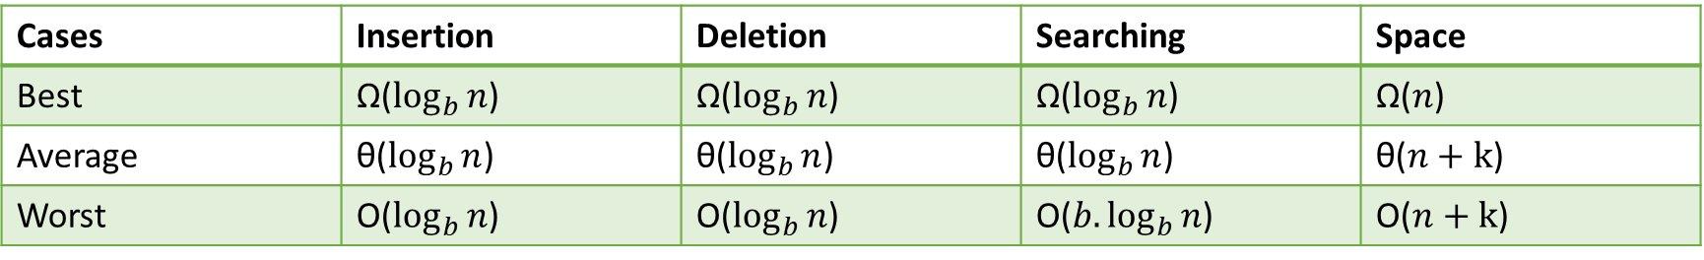
Complexities
Cases | Insertion | Deletion | Searching | Space
Best | Ω($\log_{b}{n}$) | Ω($\log_{b}{n}$) | Ω($\log_{b}{n}$) | Ω($n$)
Average | θ($\log_{b}{n}$) | θ($\log_{b}{n}$) | θ($\log_{b}{n}$) | θ($n+k$)
Worst | O($\log_{b}{n}$) | O($\log_{b}{n}$) | O(${b.log}_{b}{n}$) | O($n+k$)
Where b = order
n = number of keys in the tree

Slide 15
Comparison Analysis
Features | B Tree | B+ Tree
Storage | In a B tree, search keys and data stored in internal or leaf nodes. | In a B+ tree, data stored only in leaf nodes.
Function of leaf nodes | In B tree, the leaf node cannot store using linked list. | In B+ tree, leaf node data are ordered in a sequential linked list.
Search accessibility | Here in B tree the search is not that easy as compared to a B+ tree. | Here in B+ tree the searching becomes easy.
Redundant key | They do not store redundant search key. | They store redundant search key.

Slide 16
Applications
B+ trees are used by
NTFS, ReiserFS, NSS, XFS, JFS, ReFS, and BFS file systems for metadata indexing
BFS for storing directories.
IBM DB2, Informix, Microsoft SQL Server, Oracle 8, Sybase ASE, and SQLite for table indexes

Slide 17
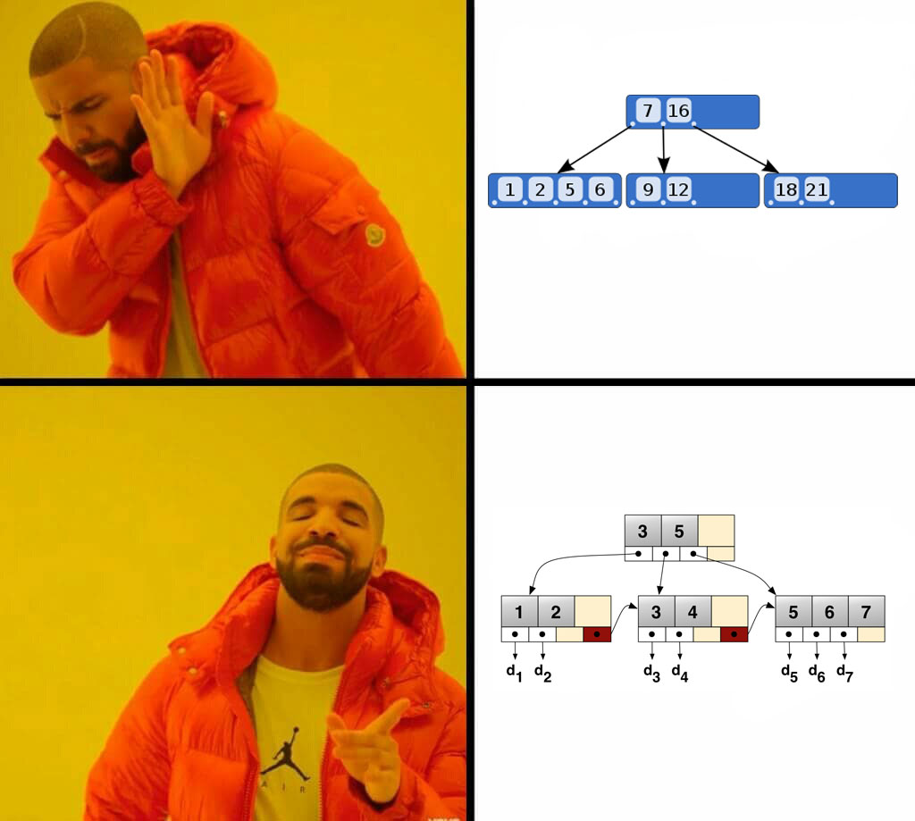
Conclusion
B Tree
B+ Tree

Slide 18
It’s a Q/A time now

Slide 19



THANK YOU
TEAM BBM

